Slide 1
UT Grad Student Taxes
2023 Edition
Written by Ryan Ellin

Slide 2
Caveats
I’m not a tax professional. This presentation is meant for entertainment purposes only
I don’t know much about international student taxes, but UT has some online resources about the topic
Tax law is complex and I might make mistakes
My goal: give a good general introduction. Some topics will be simplified

Slide 3
Introduction
You will need to deal with taxes moving forward
There are many kinds of taxes, paid by different people at different times. Ex: sales taxes, property taxes, dividend taxes
We’ll be focusing on State Taxes, FICA Taxes, and Federal Income Taxes
First, let’s cover the basic mechanics of taxes

Slide 4
Basics: Flat vs Progressive Taxes
A Flat (or Proportional) Tax is a flat percentage of your earnings which doesn’t change depending on how much you make
A Progressive Tax is a tax whose effective rate increases as your taxable earnings increase. The more you make, the more you’ll pay as a percentage of earnings
Progressive taxes use Tax Brackets: your taxable earnings are divided into chunks which are taxed at different rates

Slide 5
Tax Brackets
Think of tax brackets as buckets which are filled in ascending order: first your earnings fill the lowest rate bucket. If there is still money left over, it will then fill the next highest rate bucket, and so on
“I’ll lose money if I’m pushed into a higher tax bracket!” is a common misconception

Slide 6
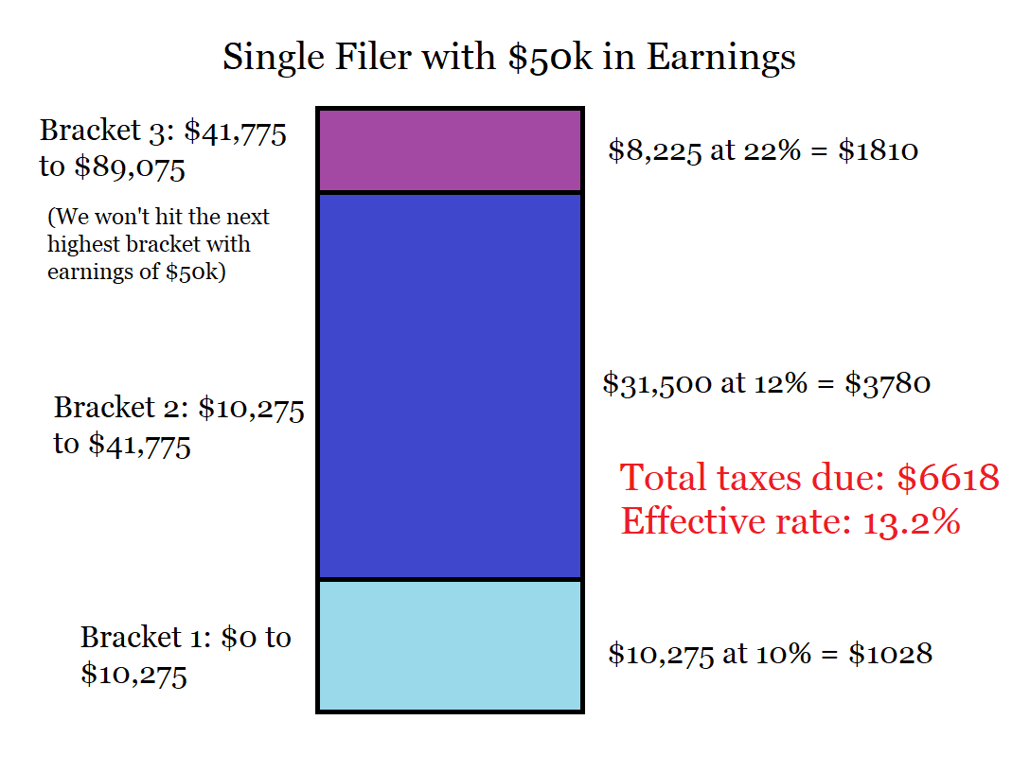
Tax Bracket Example
Example: Single filer with $50,000 in earnings (after deductions, covered later)
Under 2022 Federal tax brackets, their income would be divided into 3 chunks
Each chunk is then taxed at the appropriate rate for that year

Slide 7
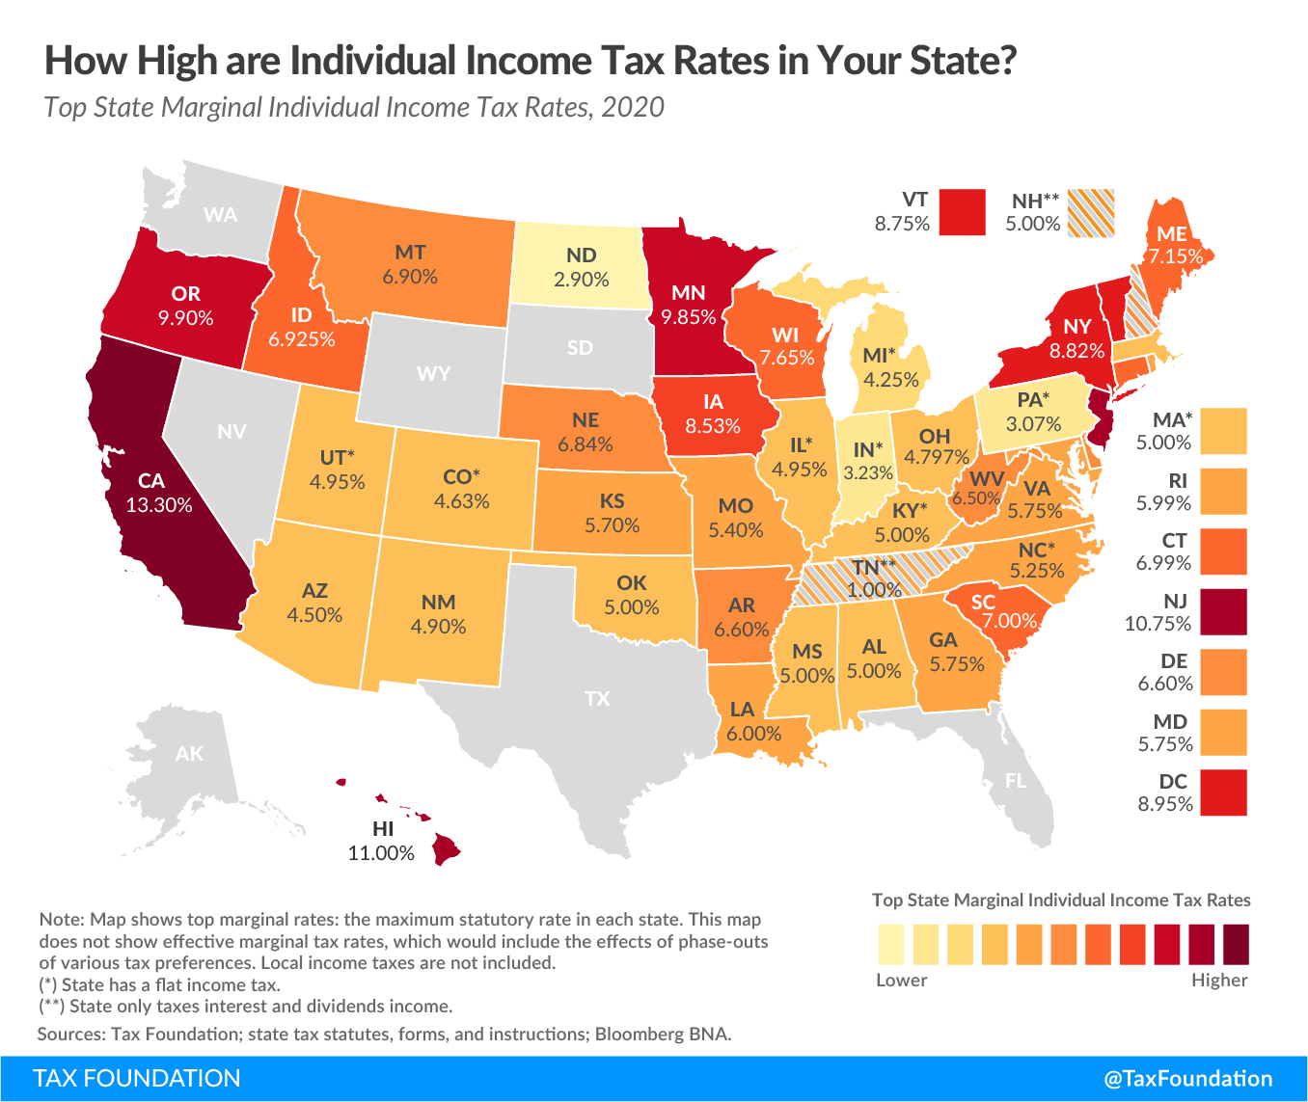
State Taxes

Slide 8
State Taxes
State Taxes are taxes you pay to your state of residence
State taxes vary significantly between states. Some have a flat tax, others a progressive tax, and some have no state taxes at all
Good news: Texas has no state taxes!
Potentially bad news: if you lived in another state for a portion of 2022, you may owe state taxes there for your 2022 filings

Slide 9
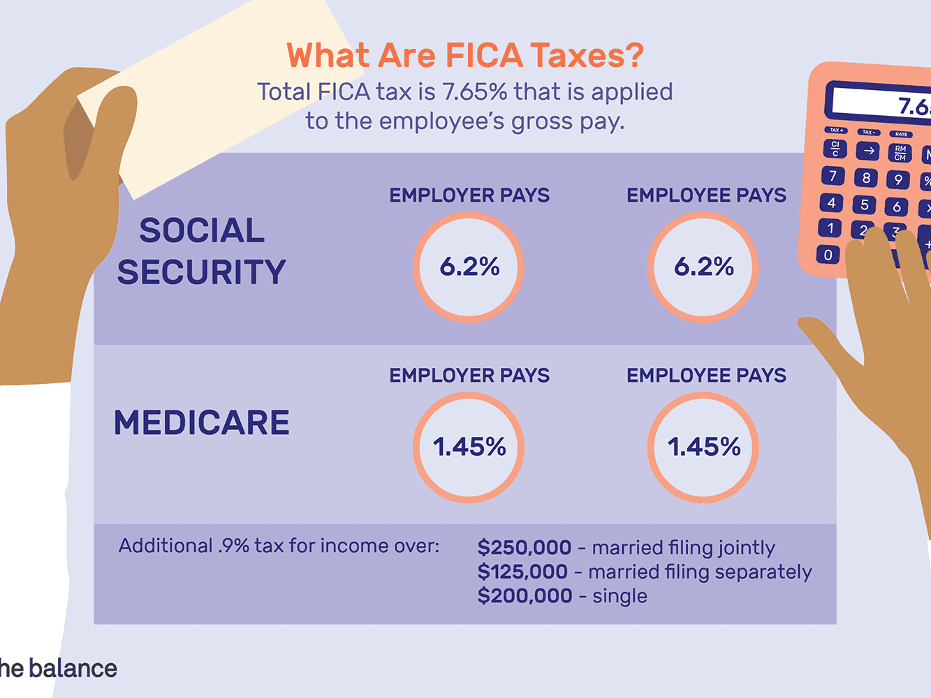
FICA Taxes

Slide 10
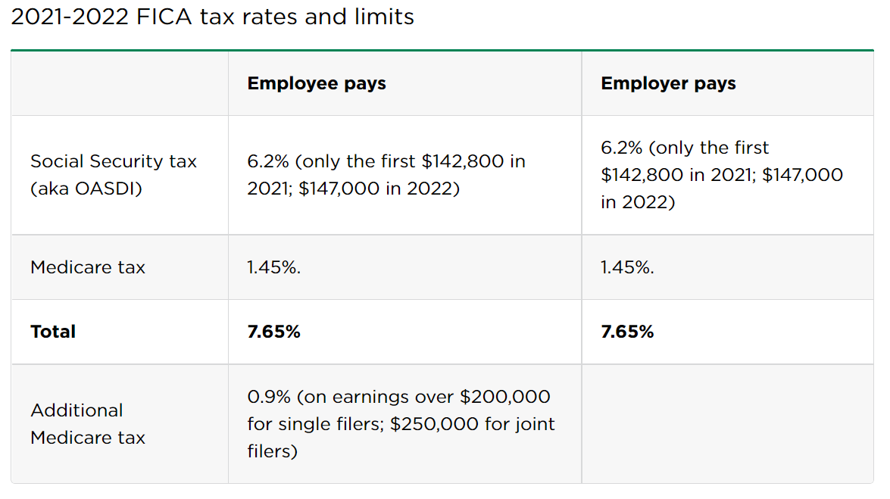
FICA Taxes
FICA Taxes: A Social Security Tax and a Medicare Tax
AKA “Payroll Taxes”
The Social Security tax is a flat tax up to a threshold
The Medicare Tax is a progressive tax
For most, this will be a 7.65% tax
Regressive tax for very high earners

Slide 11
FICA Taxes Continued
Most employees subject to “Withholding” for FICA Taxes: a portion of pay is automatically taken out (withheld)
Handled by your employer
Good news for grad students: we’re not (usually) subject to FICA Taxes! (See link below)
https://payroll.utexas.edu/payroll-info/student-employee-fica-exemption

Slide 12
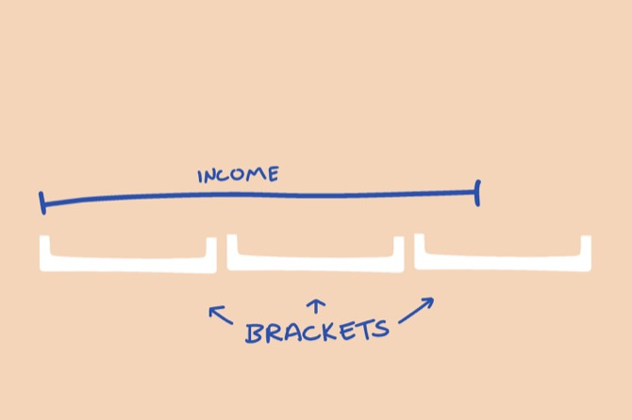
Federal Income Taxes

Slide 13
Federal Income Tax Basics
Federal Income Tax: a progressive tax on earnings which is consistent across the US
Unfortunately, grad students have to pay this
For most employees (including TAs), handled by automatic withholding on their pay
If your income is not subject to withholding (ie those on fellowships), you will need to make Estimated Tax Payments throughout year

Slide 14
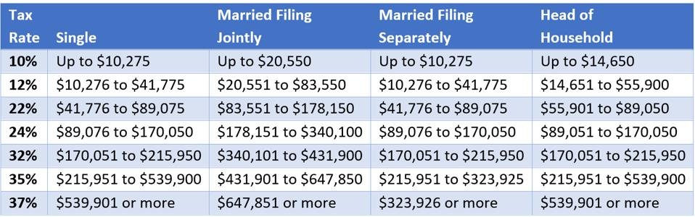
Federal Income Tax brackets (2022)
Pictured: the 2022-23 tax brackets
Brackets mostly depend on marriage
“Head of Household” means something like “single with a child / dependent”

Slide 15


Slide 16
Tax Deductions and Credits
Tax Deductions and Tax Credits reduce your federal income tax burden
A Deduction reduces your tax bill by functionally reducing your taxable income; if you made $20,000 and have a $12,000 deduction, you will only have to pay taxes as though you had made $8,000
The amount you save will depend on your tax bracket

Slide 17
Tax Deductions and Credits (cont)
A Tax Credit is a direct reduction to the amount of money owed: if you owe $2000 in taxes and you have a $500 tax credit, your tax bill is reduced to $1500
Some tax credits are “refundable” (the IRS will pay you if your credits exceed your bill)

Slide 18
Why Are Boring People (Like Me) Excited by Deductions and Tax Credits?
It’s free money!
Saving $100 on your tax bill is the same as being given $100
Learning about deductions and credits will eventually pay off

Slide 19
Itemized vs Standard Deduction
You can choose between Itemized and Standard Deductions each year
Itemized Deductions are deductions you gain by tracking various expenses throughout the year
Examples: medical bills, sales taxes, property taxes, charitable contributions, state and local taxes, gambling losses, ‘casualty and theft losses’
Aka “Below the line” deductions
Require tracking throughout year, unlikely to be useful to most students

Slide 20
Standard Deduction
The Standard Deduction is a simple flat deduction depending on marital status
Does not require tracking receipts or additional information
For nearly all grad students, the Standard Deduction wins
Standard Deduction | 22-23 Tax Year | 23-24 Tax Year
Single | $12,950 | $13,850
Married Filing Jointly | $25,900 | $27,700
Married Filing Separately | $12,950 | $13,850
Head of Household | $19,400 | $20,800

Slide 21
Quick Tax Estimates for 2022
Here are quick estimates for what you can expect to owe in taxes, barring unusual circumstances
Remember, the tax year and school year do not align. First years will often owe less (not being paid in Spring 2022)
In the off-chance some other department sees these numbers, I’m sorry if you’re underpaid ☹
Aside: stipends (such as research / travel) are usually subject to taxes
Total Pay | Federal Taxes | Effective Rate
$24,000 | $1,121 | 4.67%
$26,000 | $1,361 | 5.23%
$28,000 | $1,601 | 5.72%
$30,000 | $1,841 | 6.14%
$32,000 | $2,081 | 6.50%
$34,000 | $2,321 | 6.83%
$36,000 | $2,561 | 7.11%
$38,000 | $2,801 | 7.37%

Slide 22
Specific Education Deductions and Credits
Two mutually exclusive deductions: the Lifetime Learning Credit and the American Opportunity Tax Credit
Disappointingly, probably not very useful
There is also a Student Loan Interest Deduction

Slide 23
Lifetime Learning Credit
Lifetime Learning Credit: Tax credit of 20% on up to $10,000 on “Qualified Educational Expenses”. These are narrowly defined and are primarily focused on tuition/fees owed directly to the college.
If you receive full tuition remission, you won’t be able to claim the LLC on tuition (but thankfully you don’t owe any taxes on tuition remission ‘payment’ either)
I don’t think I personally had more than $10 per year at UT

Slide 24
American Opportunity Tax Credit
American Opportunity Tax Credit: a 100%(!) tax credit on the first $2000 in QEE, and a 25% credit on the next $2000. Partially refundable!
Expanded definition of QEE!
The catch? You don’t qualify for it after your first 4 years of post-secondary education
If you do qualify though, it’s the better of the two

Slide 25
Student Loan Interest Deduction
Shockingly, a deduction for money paid towards student loan interest. Up to $2500 per year
That’s pretty much it
Aside: if you have federally subsidized loans, they shouldn’t be accruing interest while you’re in grad school, and you should be able to put them in deferment

Slide 26
Other Common Deductions/Credits
It’s worth looking into other common Deductions and Credits to see if any apply to you
Recall /look forward to my presentation about tax advantaged accounts: their entire purpose is to gain deductions
Parents in particular gain access to some powerful deductions and credits: The Child Tax Credit, Child and Dependent Care Credit, and Earned Income Tax Credit
Don’t have children for the tax benefits

Slide 27

Practical Matters

Slide 28
Practical Matters
Next, the practical aspects of filing taxes as a grad student:
What forms will I need, and where can I find them?
When do I file my taxes, and how do I actually do that?
Potpourri: Refunds, Estimated Tax Payments
Edge Case: Kiddie Tax and Dependency
Useful informational links

Slide 29
Necessary Forms
You’ll need a Social Security Number (or other Tax Identification Number)
The standard forms you will need to file your graduate student taxes are a 1098t and (if not on full-year fellowship) a W-2 form
May need other forms depending on situation (ex: 1099-DIV if you receive dividends)
I have no idea why they’re named that way

Slide 30
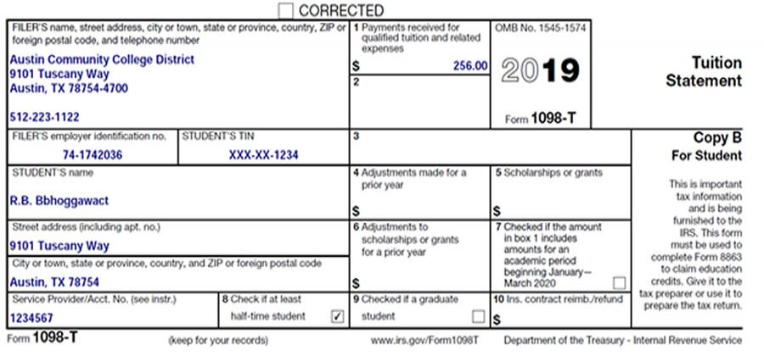
1098t

Slide 31
1098t
A 1098t reports tuition and related expenses, as well as scholarships and fellowships
Colleges must post 1098t forms by 1/31 each year
The UT 1098t form should be available at: https://utdirect.utexas.edu/acct/rec/irs1098t/index.WBX
If you attended schools other than UT in 2022 (for example, in Spring 2022), you’ll need a separate 1098t from them
Your school will probably email you about it, but you can also usually find it by googling ‘(school name) 1098t’

Slide 32
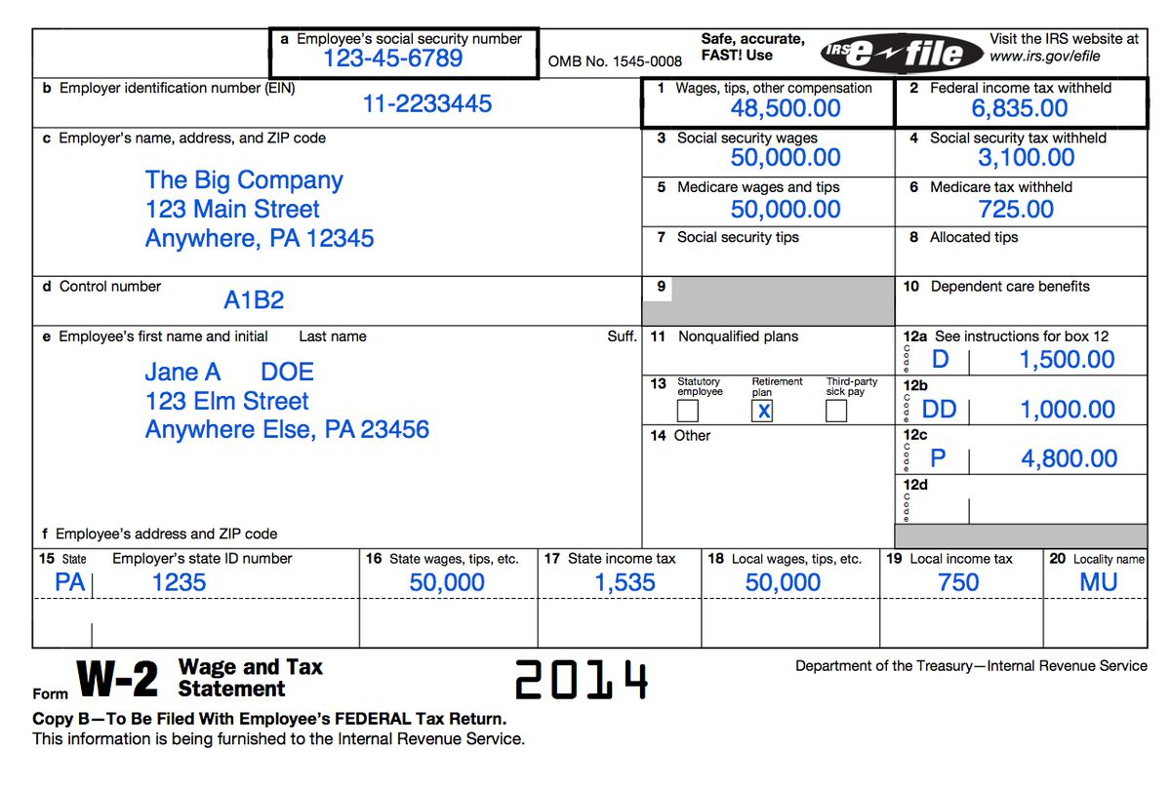
W-2

Slide 33
W-2
The W-2 form is the IRS’s standard form for employees paid wages and salaries
The W-2 is a form that you’re likely to use throughout your life
For UT: “W-2 Forms are available in Workday by logging in and clicking on the Pay application, then Tax Documents”
As with 1098t, you may have other W-2 forms from other colleges / jobs

Slide 34

When and How to File

Slide 35
When to File
The Tax Year begins on January 1st and ends December 31st (Ex: 2022 Tax year was 1/1/22 to 12/31/22)
Can take advantage of timing, move payments around
You are required to File your Federal Income Taxes (that is, fill out and submit the proper forms and pay any outstanding taxes) once per year
Filing deadline is April 15th, but can apply for extensions

Slide 36
How Do I Do That?
If very complex, might hire a tax preparer
You can, theoretically, fill out and mail in the forms by hand
Don’t do that, it’s horrible
Use free tax filing software, which will let you submit and pay your taxes online: https://apps.irs.gov/app/freeFile/
The software will guide you through the process. With the forms from earlier, it’s tedious, but not hard

Slide 37
What, really? After all that, your advice is just “use the software”?
It’s important to understand how taxes work for planning and saving
But, yeah, that’s my advice. The US has ridiculously complicated tax procedures due to a lot of lobbying by TurboTax and H&R Block
The free software really is your best choice for working through the actual filing process

Slide 38
Potpourri: Tax Refunds
It’s possible that you’ll have paid more throughout the year than you actually owe through eg withholding
If so, you’ll receive a Tax Refund: the excess will be repaid to you!
Make sure to set up Direct Deposit to your bank account when you file in this case (for convenience and safety)

Slide 39
Estimated Tax Payments
If a portion of your income is not subject to withholding, you may be required to make Estimated Tax Payments throughout the year
The rules for this are complicated, but the rule of thumb I would recommend is:
If you will receive $8,000 or more which is not subject to withholding, you may need to file quarterly estimated taxes

Slide 40
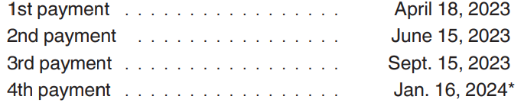
Estimated Tax Payments cont
Fellowship funding is non-withheld!
Research/travel stipends count as non-withheld income
You can do more specific estimates using the IRS worksheet 1040-ES
You can pay online, and the due dates for the payments (for next year) are:

Slide 41
Edge Case: Kiddie Tax and Dependency
The “Kiddie Tax” is designed to prevent people from reducing their taxes by giving money to their children
In simple terms: if a child satisfies the criterion of the Kiddie Tax, they are taxed at their parents’ marginal rate instead of the normal rates
Awful side effect: because of the criterion for the Kiddie Tax, it’s possible you may be flagged for this

Slide 42
Kiddie Tax Continued
As a graduate student, you may be subject to the Kiddie Tax if you satisfy the following:
You are unmarried (or married filing separately)
At least one parent is living
You are under age 24 as of 12/31 of the Tax Year in question
You were a student for at least 5 months
Less than 50% of your financial support came from “earned income”

Slide 43
Kiddie Tax Continued
The issue: fellowship funding is considered unearned income!
Therefore, those on full fellowship may satisfy these criterion
Bottom line: if you are on full fellowship, young, and unmarried, you may be nominally subject to the kiddie tax
Practical considerations…

Slide 44
Dependency
Relatedly: if you are under 24, on full fellowship, and lived with your parents for at least half of the year, they may be able to claim you as a dependent on their taxes
That might not be a good thing

Slide 45
Personal Finance for PhDs
Much of the grad student specific information of this presentation came from Emily Robert’s wonderful site, Personal Finance for PhDs
She gave a talk at UT a few years ago, coincidentally shortly after I’d given my own Sophex talk. I even got to ask her about some edge case concerns!
http://pfforphds.com/

